Slide 1
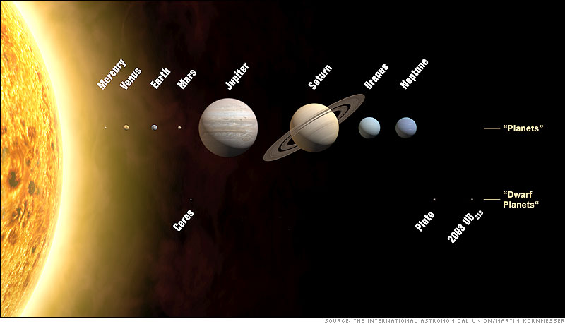
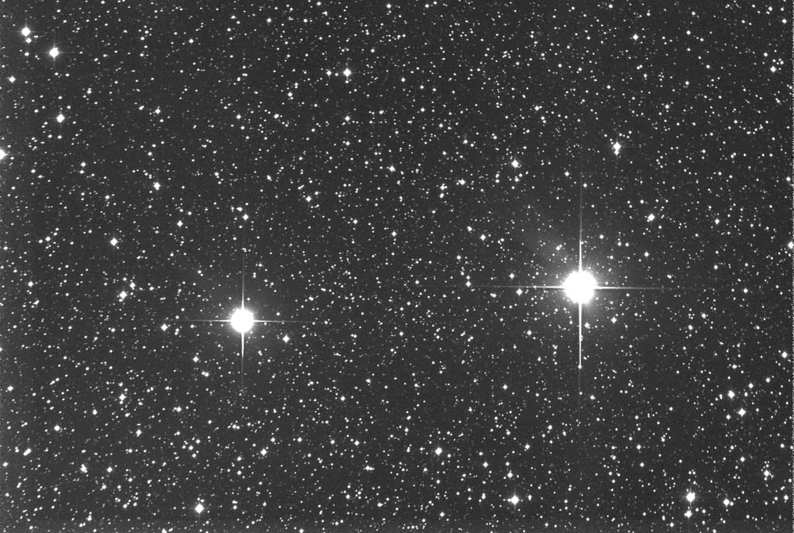
Planets & other
Celestial Bodies
By-Sanjay kumar Shandilya
Asst Master
Social Science

Slide 2
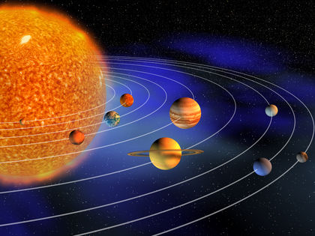
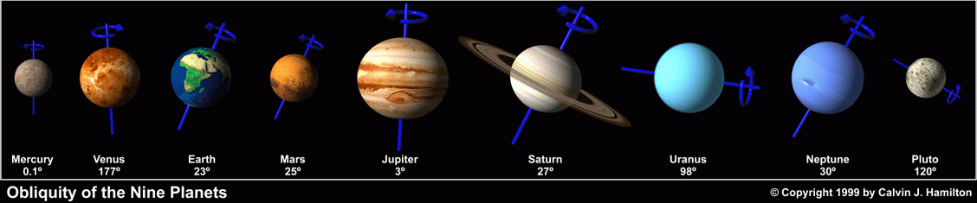
planets
-- revolve around the sun and rotate around the sun and rotate around their axes.
Revolution, which is around the sun
Rotation, their means of spinning on their perspective axes.

Slide 3
The Nine Planets

Slide 4
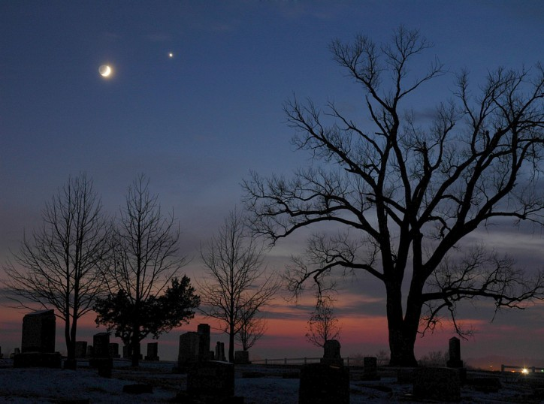
Venus as a Star

Slide 5

Differences of Star and Planet
Planets | Star
Differs from a star in its make-up in the way it glows.
Revolvers around the sun | Can’t revolves around the sun
Gives of no light of its own; instead, it reflects light from sun
Consist non-exploding elements | Is a mass of exploding gases.
Do not twinkle | Appear to do so because of the moving later of air that scatter the light.

Slide 6
The Inner Planets
Terrestrial Planets

Slide 7
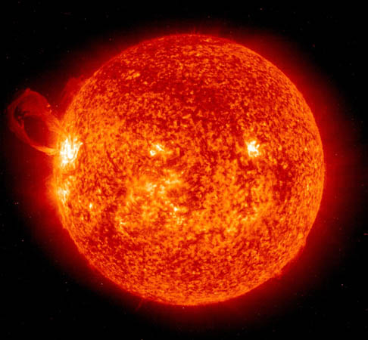
Mercury
-- Planet nearest to the sun
-- Diameter of 4,878 kilometers
-- About one-sixteenth the size of the earth
--Magnetic field is about 1% as strong as that of the earth
-- Fastest of the nine Planets
--revolves around the sun in 87.97 days.
-- Rotation is 58 days, 15hours and 28 minutes.

Slide 8
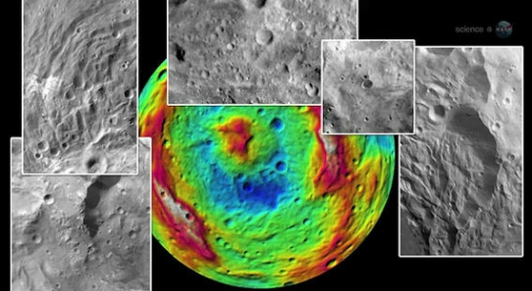
Mercury
-- can be observe on earth as the morning and evening star.
--Mercury’s surface is filled with craters and crisscrossed by ridges and cliffs
-- Temperature : 425 Degrees Celsius on day side and 175 degrees Celsius in night side or the side away from the sun.
-- it has a thin atmosphere of helium, supplied by solar wind, according to the Mariner 10 space probe

Slide 9
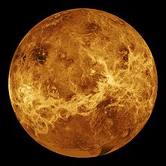
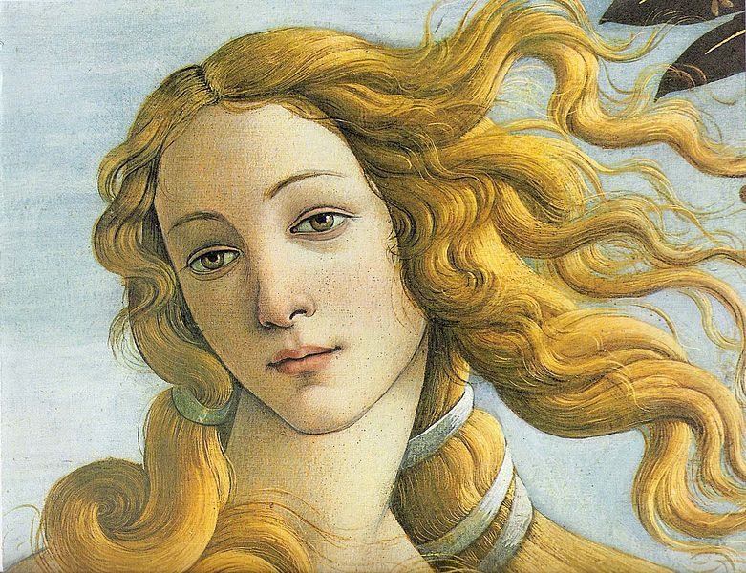
VENUS
-- Can be seen as evening star and as a morning star.
-- named by Roman Goddess of love and beauty because as seen from the earth.
-- it’s brightly just after sunset in the western skies during the spring and summer months.
-- it takes 225 days for Venus to orbit the sun.

Slide 10
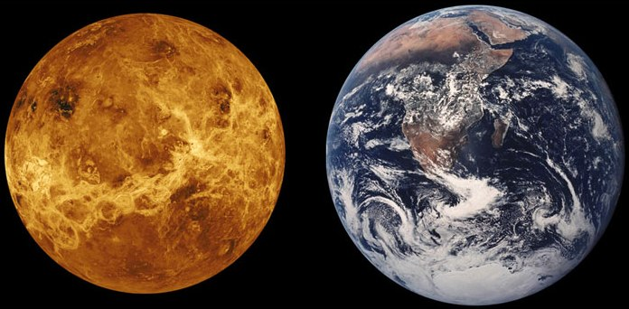

V
E
N
U
S
-- Stargazers refer to Venus
as the earth’s twin.
Diameter : 12,104 kilometers. Same size as the earth and their masses and surface gravities are close

Slide 11
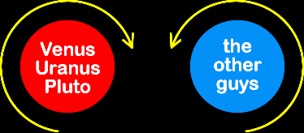
First
-- Venus like Uranus spins or retrograded unlike spin of the rest which is counterclockwise.
SECOND
-- it rotates 243 days, longer than it takes for it to revolves around the sun.
THIRD
-- its dense and cloudy atmosphere is an excellent reflector of light.

Slide 12
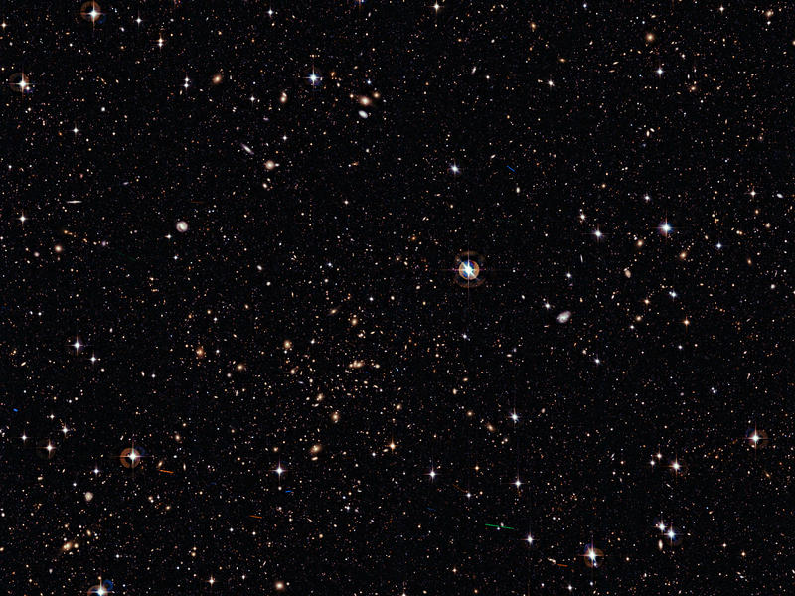
TEMPERATURE : at the surface ranges from -30 to 475 degrees Celsius making the hottest planet .
ATMOSPHERE : is made up of more than 90% CO2 and almost no oxygen.
CARBON DIOXIDE : helps to reduce a powerful greenhouse effect in Venus.
GREENHOUSE EFFECT
: the nearness of Venus to the sun raises the temperature on the surface to more than 475 degrees Celsius, high enough to melt lead.

Slide 13
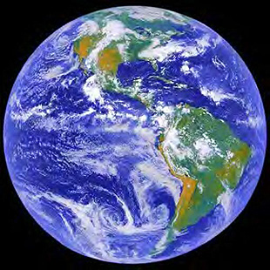
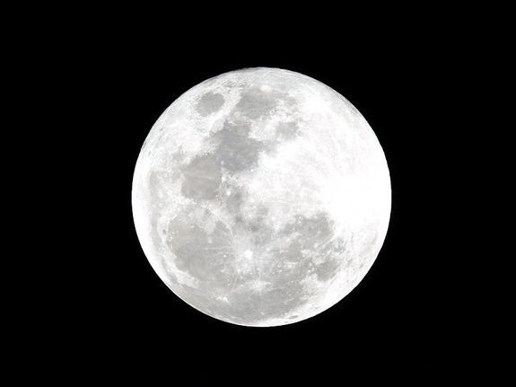
E
A
R
T
H
-- the only planet known to support and have intelligent life.
-- it has an atmosphere that makes it possible for life to flourish, the others are blanketed by boiling, poisonous gases.
--Earth day is 24 hours which is the time it takes our planet to complete its rotation on its axis.
-- The earth is farther away from the sun than Mercury and Venus, it makes a complete revolution of about 365 days.
-- Our planet has one Satellite Called Moon or Luna

Slide 14
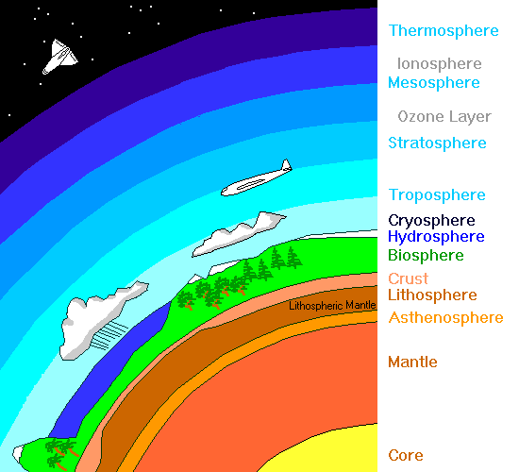
Earth’s Three Main Layer

Slide 15
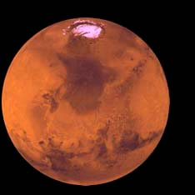
-- Earth’s closest celestial neighbor beyond the solar orbit.
-- Mars is Reddish color , that’s why it called the Red Planet.
-- Ancient stargazers associated the Red planet with disaster on Earth.
-- The Babylonians called Mars as the “ Star of Death.
-- The Romans named it after their god of war.
MARS

Slide 16
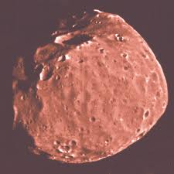
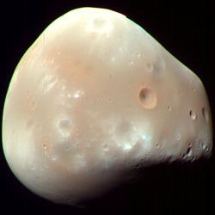
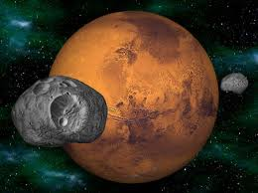
Two Satellites of Mars
DEIMOS
-- Greek Word for Terror.
Phobos
-- Greek word for Fear.

Slide 17
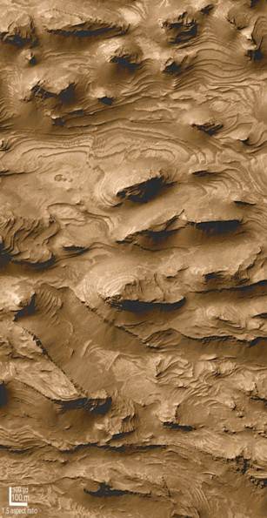
M
A
R
S
Diameter :
6,794 kilometers smaller that earth core.
Its spin once in 24 hours, 37 minutes.
-- It takes 687 Earth days for Mars to revolve around the sun which means that seasons on Mars are almost twice as long on Earth
Has a thin Atmosphere. Floating clouds, violent dust storms, and white polar caps can be seen easily in photographs.
Its made up chiefly of Carbon Dioxide. Water Vapor, Oxygen, and Nitrogen – each so important life in Earth, are SCARCE.

Slide 18
MARS
It has no ozone in its atmosphere to react with deadly radiation from the sun.
Temperature :
The Equatorial Region on the Red Planet approaches 30 degrees Celsius on a hot day. But when the sun sets, the temperature drops rapidly to -75 degrees Celsius.
Many like to think that there's a life in Mars . This idea became a popular when an Italian Astronomers sighted a network of what seemed to be straight lines on the surface of Mars.

Slide 19
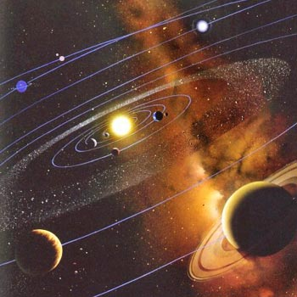
THE OUTER PLANETS
or
JOVIAN PLANETS

Slide 20
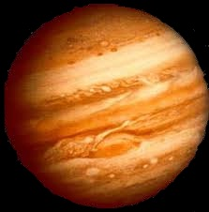
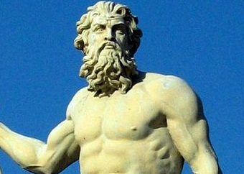
JUPITER
Is the Giant member of the planetary system.
It was named by a Roman God.
The god of Jupiter was also known as Jove, thus , Jovian is the adjective form used by astronomers to describe the planet.

Slide 21
Has 318 times more mass than the Earth.
Has more material than all other planets and their satellites put together.
Diameter is more than 11 times greater than the earth’s . Yet massive planets rotates quickly.
A day in Jupiter is only 9 hours and 55 minutes , making it fastest-rotating planet. No other planet spins so fast.
JUPITER
-- is a strange place. It has so much mass that its gravity is 2.6 times greater than the earth’s.

Slide 22
JOVIAN ATMOSPHERE
-- made up mostly of hydrogen and helium.
-- it contains also some methane and ammonia.
-- No free oxygen has been found. Its atmosphere is very cloudy, thus it is impossible to see through it.
-- Jupiter has no real surface at all. At depth of rough 165km, the pressure of the Jovian atmosphere is so high that gases in the atmosphere liquefy, resulting in a hydrogen-helium ocean.
-- Deeper into the Jovian atmosphere, the pressure is even greater. At 245km, some of the hydrogen-helium mixture turns slushy. Finally, it becomes solid. Thus, Jupiter is a huge ball of hydrogen mixed with helium. Some parts of the mixture are Solid; others Liquid; and still others, gas.

Slide 23
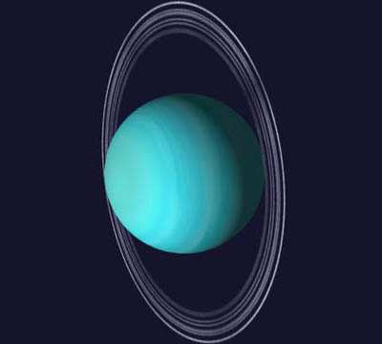
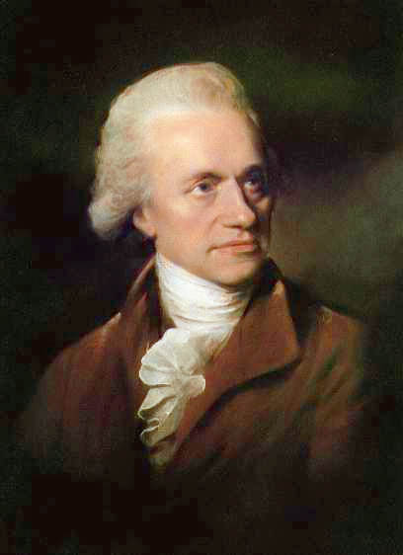
UrAnUs
In 1781, William Herchel of England discovered a planet was later named URANUS.
Is third Largest planet in the solar system.
Diameter :51,118 kilometers
84 earth years for the planet to orbit the sun
And 17 hours and 15 minutes to rotate its axis.
Due to its great distance from the earth, very little is known about Uranus which looks like a rather featureless, pale green disk.

Slide 24
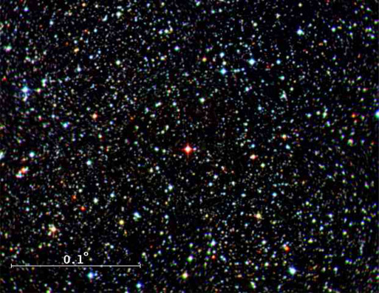
Hydrogen and Methane have been detected in its atmosphere.
It has a very low temperature – 170 degrees Celsius , in which ammonia gets froze (iced)
Its axis of rotation is only 8 degrees from plane.
Its inclined almost 90 degrees, the sun is nearly overhead at one pole. Each revolution later the sun is overhead at the other side
Uranus

Slide 25
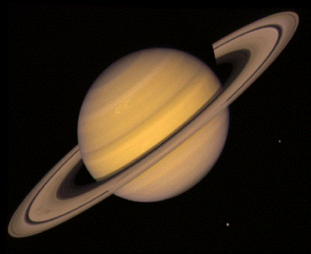
SATURN
-- Second Largest planet in Solar System.
-- at first glance, it may look like a smaller model of Jupiter.
-- Diameter is 9 ½ times that of the earth.
-- It has 95 times more mass than the earth and its period of rotation is 10 hours and39 minutes .
-- A day in Saturn is only an hour longer than a day in Jupiter.

Slide 26
saturn
Has several special features of its own.
It has a low density of 0.7 gm/cc. which is less than the density of water
It is believed that Saturn may be made of loosely packed snow and ice.
Deep below its outer edge, the highly compressed atmosphere of Saturn turns into a thick hydrogen core. Deeper still, the core of the planet is solid and hard.

Slide 27
SATURN
-- most unusual things about Saturn is its magnificent system of rings.
-- rings are only a few kilometers thick.
-- photographs, they look like a wide brim of a straw hat.
-- the ring of saturn are not solid
-- They are made of countless ice-coated particles
-- particles are quite small and they revolve around the planet like tiny satellites

Slide 28
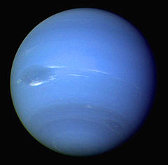
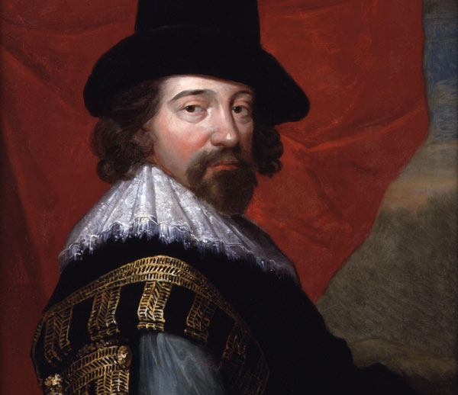
NEPTUNE
-- using the calculation of these young astronomers sighted the troublemaker in 1846.
-- the newly discovered planet was called NEPTUNE
-- Neptune and Uranus are like twins
-- besides being similar in size, they both appear as pale green due to methane in their atmospheres.
-- Neptune is farther away, it is believed to be older than Uranus.
John Herschel

Slide 29
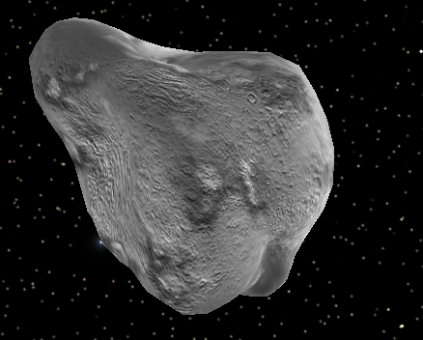
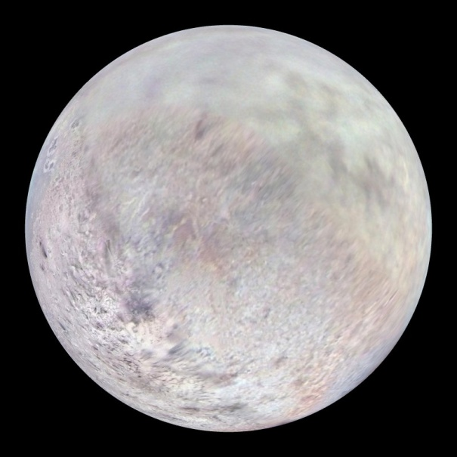
NEPTUNE
-- 1984 observation indicated an object 10 to 20 km wide but at least 90 km long
-- according to US spacecraft Voyager 2, has set a broad sheet rings which extends inward from a distance of 59,000 km.
-- Atmosphere present in Neptune are hydrogen, methane and ethane.
Nereid
triton

Slide 30
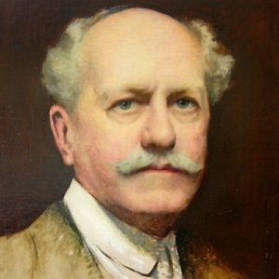
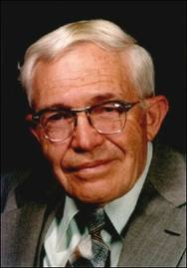
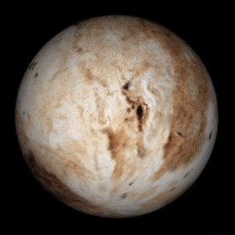
-- The location of this planet was calculated by Percival Lowell of the United States.
-- Lowell died without even seeing the new planet.
-- It was discovered in 1930, 14 years after his death, by Clyde W. Tombaugh.
Percival Lowell
Clyde W. Tombaugh
Pluto

Slide 31

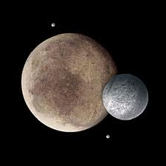
--June 1978, an American astronomer, James W. Christy discovered Pluto has a moon.
Diameter :
2,290 kilometers with composition estimated to be 74% water ice, 21% rock and 5% methane ice.
-- In the late of 1970s, spectroscopic examination showed that its atmosphere is thin methane gas probably from methane ice on its surface and accompanied by unknown gases.
Charon

Slide 32
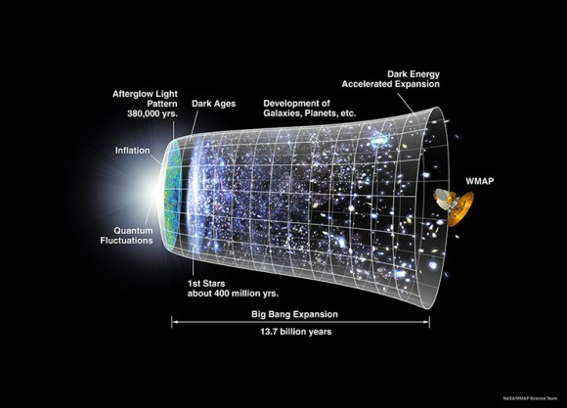
Other celestial bodies

Slide 33
comets
-- People now look forward with interest to sighting a comet but for many centuries, comets were believed to have an evil influence on human affairs; particularly, they were believed to foretell plagues, wars and death.
-- it was once thought that comets made of vapor that had risen from the earth.
-- It was not until 17th century that they began to be properly understood.

Slide 34
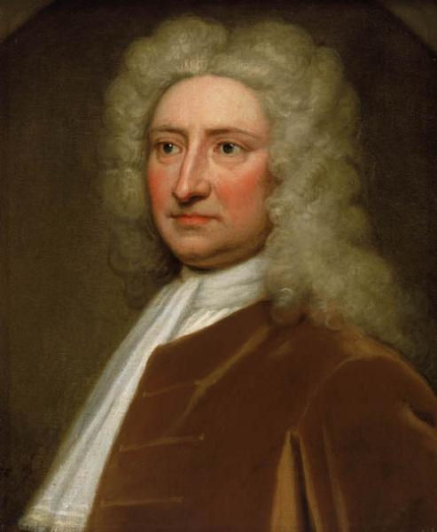
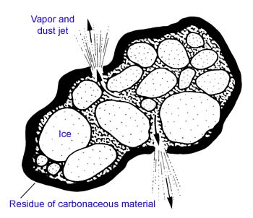
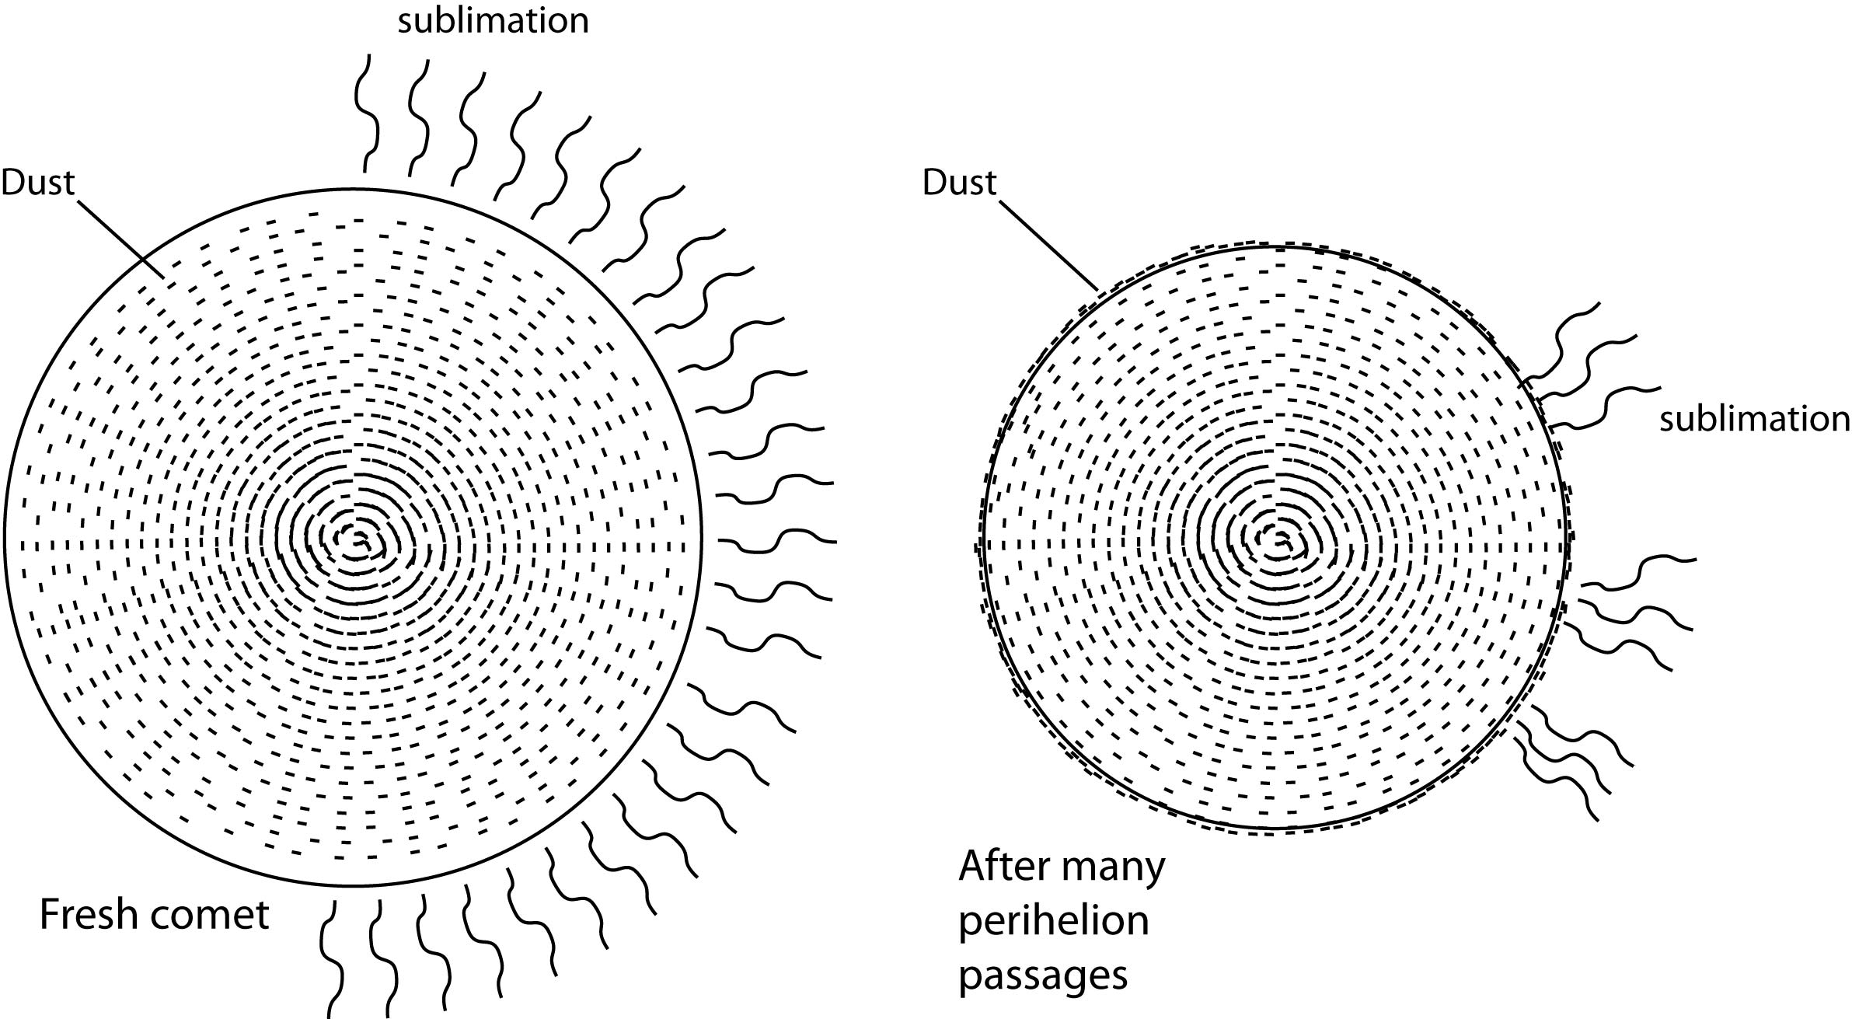
-- In 1682, a comet appeared and was observed by the astronomer Edmund Halley; it was later named after him.
-- He studied the written accounts 24 comets that had been appearing from the time since1337.

Slide 35
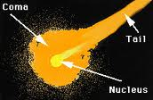
-- As a comet comes near the sun, its ice begins to sublimate, to pass directly from solid gas. The gas carries with it some of the loosely bound dust particles.
-- the gases spread out around the nucleus, forming a large, thin atmosphere called Coma.
-- As the comets approaches the sun, the solar wind, which consist of high-speed atomic nuclei, protons and electron, sweeps cometary gases away from the sun, producing a straight tail of up to 93 mile s in length.

Slide 36
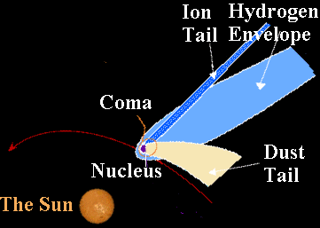
-- Second tail, consisting of dust particles may also appear. This dust tail is shorter and more curved than the gas tail.
-- Comets tail always point away from the sun because of the force exerted by solar wind and radiation on the cometary materials.
Comet loses some its mass every time it swings about the sun.
A comet dies also because the gases that form its tail fly off into space.
In time, all the frozen gases of the comet’s nucleus evaporate. Then the comet break apart.

Slide 37
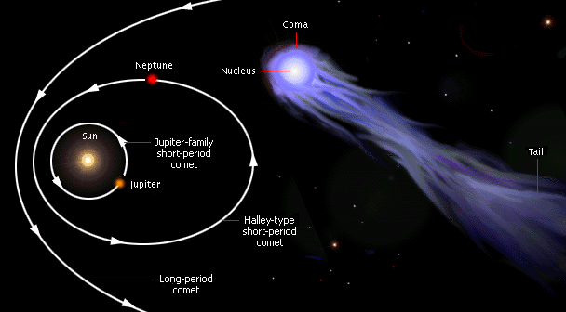
Comets divided in two groups:
--Short-period of comets with orbital periods of less than 200 years
-- Long-period comets with period on the order of million years.

Slide 38
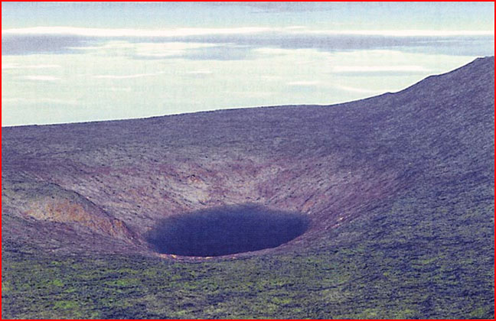
TUNGUSKA
EXPLOSION
-- that occurred in 1903 in Central Siberia is thought to have resulted from such a collision

Slide 39
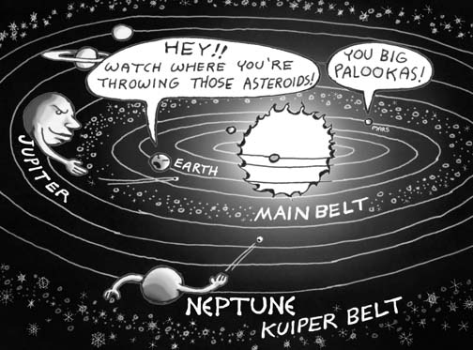
Asteroids
-- The nine planets and their moons are not alone in space.
-- There are heavenly bodies in the solar system that, like the planets, revolve around the sun in fixed orbits.
-- there are fifteen hundred asteroids within the solar system. Most of them travel in an orbit between those Mars and Jupiter, called the asteroid belt.

Slide 40
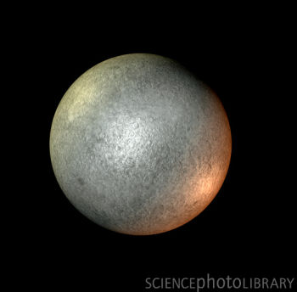
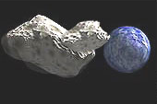
THE LARGEST ASTEROIDS
CERES
--with a diameter of 480 miles. Most of asteroids only have diameters of less fifty miles.
Hermes
Asteroids come quite close to earth and Hermes is the one of them.

Slide 41
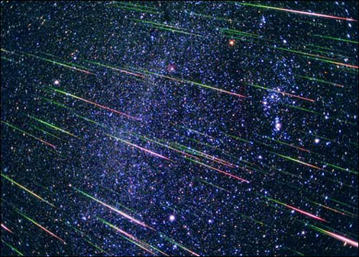
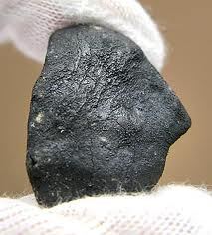
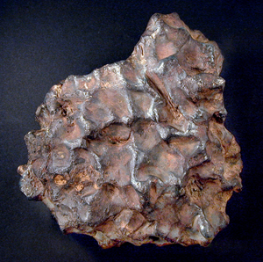
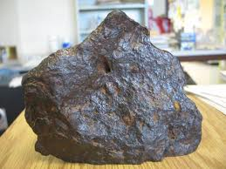
meteors
--are popularly known as “ Shooting Star “ or “Falling Star”, but actually they are not star.
-- they are lumps or irregularly shaped masses of metals or rocks that are speeding around in space.
-- when such a swiftly moving body penetrates the atmosphere and becomes so heated from air resistance that it begins to glow, it is called METEORITES

Slide 42








The Largest Asteroids
Ceres
Vesta
Hygeia
Pallas
Euphrosyne
Interamnia
David
Cybele
Europa

Slide 43




Meteor
-- which are initially cold and dark masses, blow up when they enter the earth’s atmosphere. This happens because of the resistance of the atmosphere and the friction among meteors, causing them to burn and glow.
--They are called “Falling Stars” because of their apparent brightness and the motion they make against background of a fixed star. To observers, they looks as if they are falling.
Iron meteorites
-- are made of iron, nickel, and other metals that can be also fount on Earth. They classified into three :
Stone Meteorites
Stony Meteorites

Slide 44

The Stars, Galaxies, Constellation, and The Universe

Slide 45


Star
-- are heavenly bodies with so much central heat an pressure that energy is generated in their interiors nuclear reaction
-- The most familiar stars visible in the night sky are ball of gas with solar composition, and the sizes usually a few times smaller or larger than the sun.

Slide 46



NAMES OF STAR
-- are named and catalogued by several systems. When Ptolemy’s Almagest was passed on to Arab astronomers, many of the stars ended up with Arabic names.
-- Al is the common Arabic article, many stars start their names with Al; e.g., Alel, Altair and Alcor.
-- The brightest Star in the constellation is called Alpha Centauri.
-- Fairer Star or Stars unusual properties are often known English Letter or catalog number such as T Tauri or B.D 4 + / -4048.
0

Slide 47



PROPERTIES OF STAR
1. Magnitude
This refers to the brightness of the star. The brightness known star was assigned first magnitude and dimmest was sixth magnitude.
2. Color and Temperature
In getting the magnitude, astronomers discovered certain interrelationship like color and temperature. Color is a result of temperature. Red star are less hot than Yellow star. The hottest types are the Blue-white stars.

Slide 48

3. Composition
A spectroscope is used to study the composition of stars. As the stars become older, their composition, surface, and luminosity change.
4. Proper Motion
There is very little movement among star. Some star show proper motion of 1 second or more of arc per year, other may show seconds of arc per 100 years.

Slide 49


5. Radial Velocity
This type of motion shows whether a star moving in a line away or toward the earth. From the spectral lines coming from starlight, radial velocity can be taken.
6. Size
The size of a star may be determined by interferometry. The technique called speckle photography obtains an image on the surface of a big star.

Slide 50

7. Stellar distance
Astronomers generally express distance between star in Parsecs. The distance in parsec is equal to one divided by the parallax angle. Parallax is the apparent shift of an object when viewed from two different places.

Slide 51
Stars Groupings
1. Open Star Clusters
-- are moderately close nit, irregularly shaped groupings of stars. They usually contain 100 to 1,000 members and are about 2 to 20 pc in diameter.
2. Associations
-- are contains open clusters. They often have fewer stars but are larger in size and have a looser structure. Some large association include an open star cluster within them.
3. Global Star Clusters
-- are quite different from the two types. They are more massive, thickly packed, symmetrical and very old. They typically contains from 20,000 to several millions star, although many of these crowd too close to be resolved by the earth-based telescopes. Typical diameters of central concentration range 5 to 25 pc

Slide 52

Milky Way
-- our exploration of space has taken us out to distance a few thousands of parces. By looking at the distribution of stars and cluster throughout the volume of its size, we begin to perceive the Milky Way galaxy. The Galaxy is a mass of innumerable stars planted together in cluster.
-- The Globular cluster have an average age of around in 13+/-4 billion years. Because they are believed to be among the first objects formed as the galaxy took form, their age is estimated to be 13 billion years, believed to be approximate age of the galaxy.

Slide 53
Our galaxy contains a range of star types of different composition, age, distribution, and orbital geometry. They are commonly into two major groups:
1. Population I
Star of solar composition which have relatively young ages and are distributed in nearly circular orbits in the galactic disk . Like the sun and other stars in the galactic disk, they have varied ages from zero to billion years and are located where stars still forming.
2. Population II
Star that are nearly pure hydrogen and helium with no heavy elements; these are old and associated with globular cluster that have orbits taking them far above and below the galactic plane. These star are all around 13+/-4 billion years old.

Slide 54

Constellation
If you take time to study the star for a while, you will find out that they fall into patterns and designs imposed by our mind.
Sky watcher during the ancient times perceived stellar patterns and called such patterns constellation.

Slide 55
Habitable planets
Even planets exist near some other stars, there is no guarantee that they are habitable. Astronomers have proposed condition needed to make a planet habitable :
1. The central star should not be more than 1.5 M. so that it will last long enough for substantiated life to evolve at least 2 billion years and will not kill evolving life with too much UV radiation which breaks down organic molecules.
2. The central star should be at least 0.3 to be warm enough to create a larger orbital zone in which planet could retain liquid water.
3. The central star should not flare violent or emit strong X-Trays. It should be on the main sequence in order to be stable, long enough to give its planet long-term climatic stability.
4. The planet must orbit at the right distance from the star so that liquid water will neither evaporate nor perm permanently freeze.
5. The planet’s orbit must be circular and stable enough to keep it at a proper distance and prevent drastic seasonal changes.
6. The planet’s gravity must be strong enough to hold a substantial atmosphere.

Slide 56

The Instrumental Used to Study Astronomical Bodies
Stellar Spectroscope
-- The simplest spectroscope consist of a glass or quartz or prism or, more commonly today, a diffraction grating placed in front of the objective lens of the telescope. Light collected by the telescope passes through the prism where it is split into its components, producing a characteristic spectrum.

Slide 57

Chronograph
-- is an excellent means of recording astronomical observation accurately and permanently. A revolving drum covered with a sheet of paper causes a pen to trace a continuous line on the sheet. The main observation clock is connected with this device, and an electric contact marks off each second. Any series of observation involving time. Such as star transits, may be run onto the chronograph, and such signals are recorded as breaks in the otherwise continuous record of time on the sheet.

Slide 58


Spectograph
-- is an exceeding valuable instrument; indeed, some observatories specialized in research in stellar spectroscopy. Photographs made with this device reveal, in the arrangement of spectral line, the elements composing the various stars. ( Each elements always gives lined space at definite interval in the band of electromagnetic radiation). Such photographs mat be made in a few minutes or several hours, depending the star’s brightness.

Slide 59


Refracting Telescope
-- is a telescope which uses lenses to refract light. This refraction causes parallel rays to converge at a focal point; while those which were not parallel converge upon a focal plane. This can be enable a user to view a distant object if it were brighter, clearer, and/ or larger.
Pyranometer
-- the LI-COR pyranometer (LI-299SA) measures global solar radiation. It is a photodiode covered by a plastic disk.

Slide 60

Spectrohellograph
-- Basically, the spectrohellograph has two spectrographs mounted back-to-back. The second spectrograph reverses the dispersion of the first one. An intermediate slit between the two allows the bandwidth to be selected.
-- The spectroheliograph rides on an oil hydraulic system. This allows the entrance slit to scan across the image of the sun.

Slide 61

Pyreheliometer
-- is used to measure the beam component of solar radiation. The detector, a multi-junction thermocouple, is positioned at the end of collimating tube. The detector is coated with optical black and temperature compensated to minimize sensitivity to temperature fluctuation.

